Slide 1
Real Time Bot Detection And Heat Analysis
Zirui Tan, Zichen Liu,
Haopeng Zhang, Yuting Wang

Slide 2
Problem Definition
Introduction:
Live video provides a way for hosts to be popular.
There are amounts of bot barrage in the live video. The heat of the hosts shown by the platform may be fake
Besides, we calculate the real heat depending on our detection.
We further find out the increasing edge of the barrages and high frequency words for analysis of hosts operation.

Slide 3
What we do
Bot detector
Barrage event detector
Heat analysis

Slide 4
Rules
· How we construct the rule to determine if a user is a bot?
We examine the script in the internet which send bot chat message, which tells us that actually the bot message will be sent in short time with same message.
The script will send 3 messages in short time, after that it will change a account to send the same messages over and over again.( We can use this property to recognize a bot !! )
But, we should be aware that sometime, when there is a heat in barrage information! ( this time, a lot of people may send messages in short time )

Slide 5
Algorithm
We first accumulate all the barrage to generate the current barrage dictionary.
Then we divide the streaming data into two parts: real bot and suspect bot, depending on the record.
As for the real bot, we accumulate the barrage of them to barrage dictionary.
As for the suspect bot, we add scores depending on the level of the user, the barrage content, the barrage interval and current barrage. There is a score threshold to determine whether it is a bot or not.
Finally, we will record new bot and update bot dictionary and barrage dictionary.

Slide 6
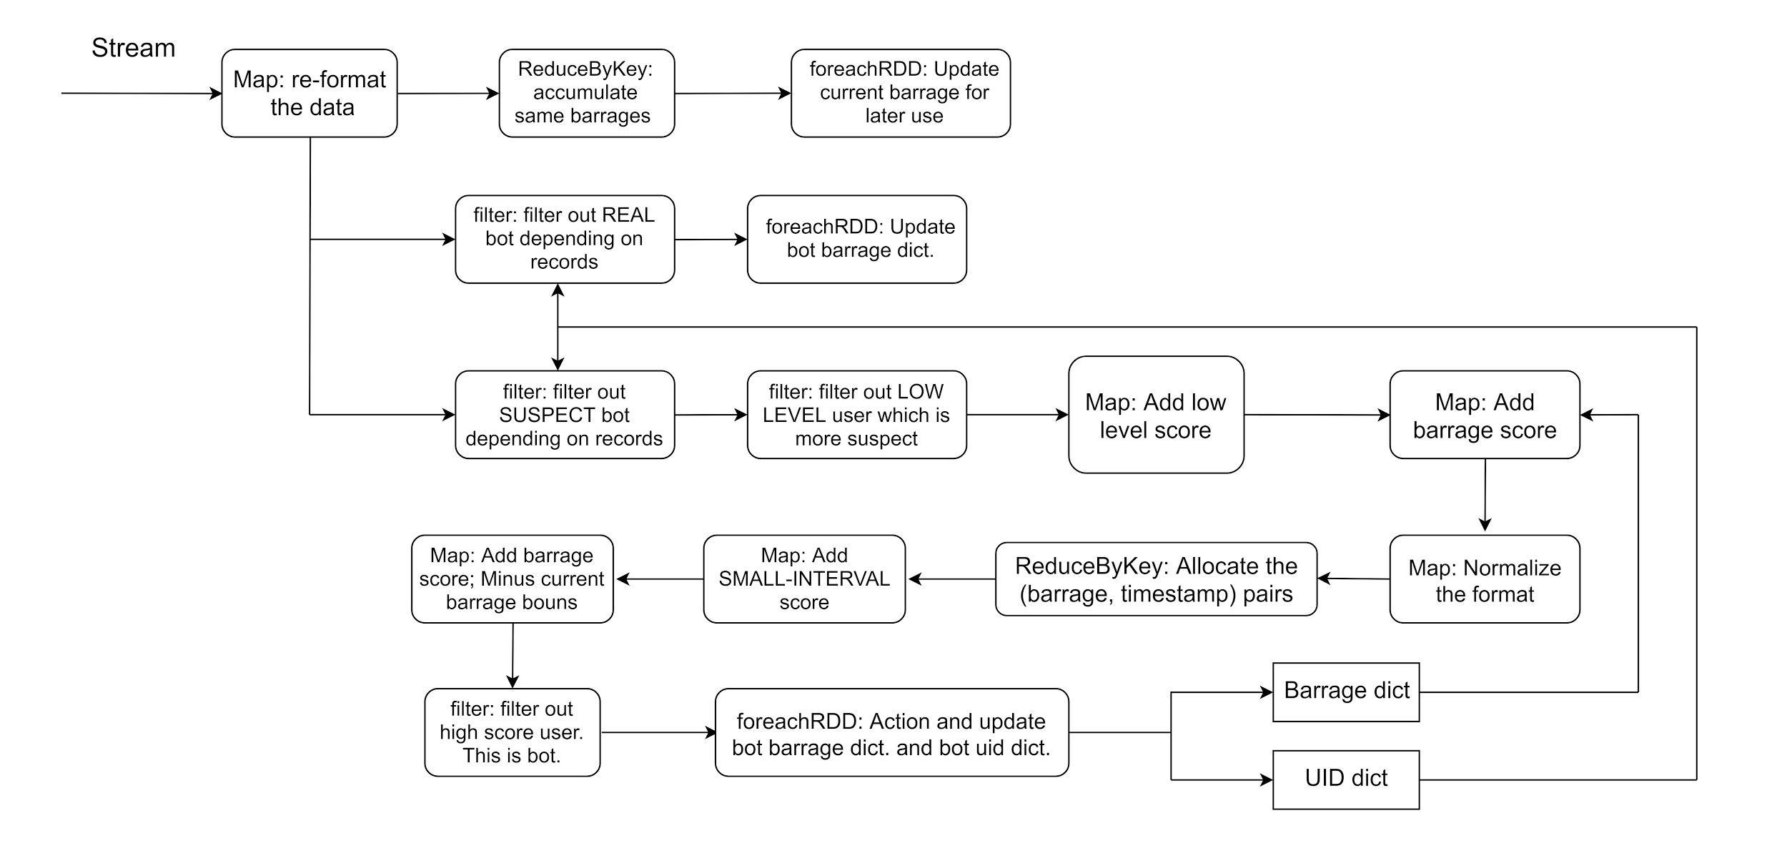
Bot detector

Slide 7
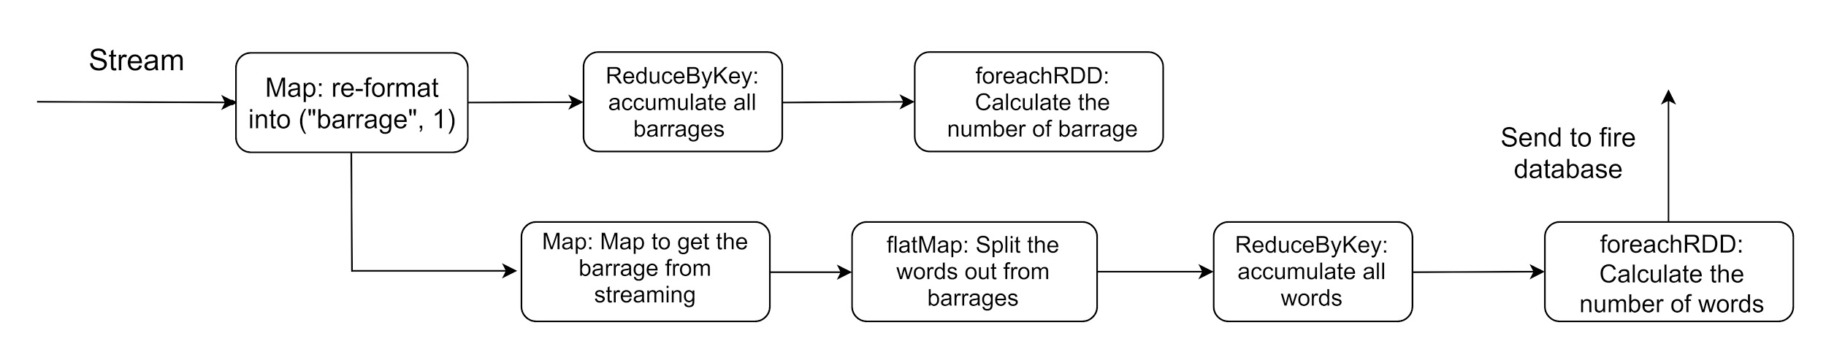
Barrage event detector

Slide 8
Real Time Heat Analysis
Every 10 seconds, update the heat data
Call api to get the online numbers and gifts collection;
Calculate the gifts weight based on the value of each gift type in time period
Calculate the barrage weight based on the processed barrage information
Calculate the online number weight as below:
online number = (curr_number / pre_number) * 100
Calculate the real time heat:
heat = (online_number * 0.6 + gift * 0.2 + barrage * 0.2) * (1-a) + pre_heat * a

Slide 9
Problem Faced
The variables that needed between batches
Reasonable algorithms to detect the robot and calculate heat
Real-time visualization
Find out suitable parameters (scores, batch window size, weight of heat parameters)
Design test unit

Slide 10


Technical Details
1. Rules for detecting bot
2. Algorithm
3. Data Visualization
Streaming Process

Slide 11
Reference
[1] https://spark.apache.org/docs/latest/
[2] https://firebase.google.com/docs
[3] https://open.douyu.com/

